Slide 1
Resnet50 and
Inception net

Slide 2

Introduction
Name: Munia Shaheen
ID : 20101050
Name: Akib Zabed Ifti
ID : 23341129
Name: Fateha Jannat Printia
ID : 20301357
Name: Rakibul Hassan Hredoy
ID : 20101357
Name: Hamim Ibne Nasim
ID : 20301443
Name: Rubaba Rashid
ID : 20301267

Slide 3
Problem Description
Augmentation
Performance metric
The Structures
Train Test Curve
Misclassified test images of the models.
A decision of which model performs better.
Milestone - 1 improvement

Slide 4
Milestone - 1 improvement
Augmentation
Sharpening
Logistic iteration
Neural network hidden layer
CheckPoint add

Slide 5
Augmentation
Horizontal and Vertical Flipping
Increased Robustness :
Improved model adaptability
Regularization:
Mitigates overfitting.
Improved Generalization
Enhances object recognition.
Data Efficiency:
Maximizes data utilization.

Slide 6
Resnet 50
Sensitivity
0.236
Accuracy
24.40%
PPV
0.244
NPV
0.81
Specificity
0.81
F1 Score
0.23

Slide 7
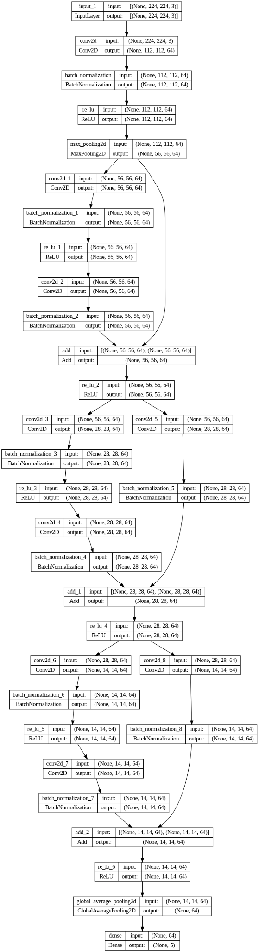
Structure
Of resnet

Slide 8
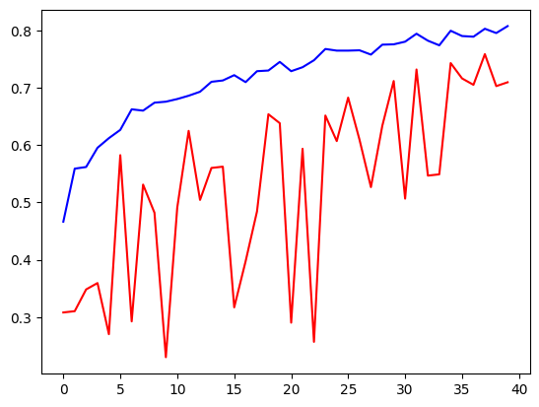
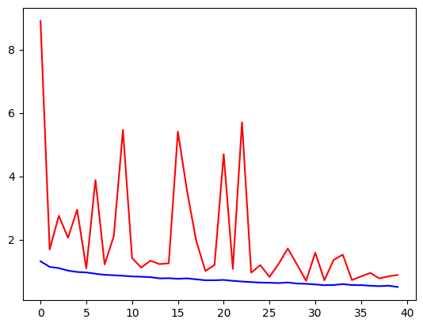
History of train and test (resnet)
Loss of train test accuracy of train test

Slide 9
Inception
Sensitivity
0.224
Accuracy
22.20%
PPV
0.218
NPV
0.806
Specificity
0.8-6
F1 Score
0.22

Slide 10
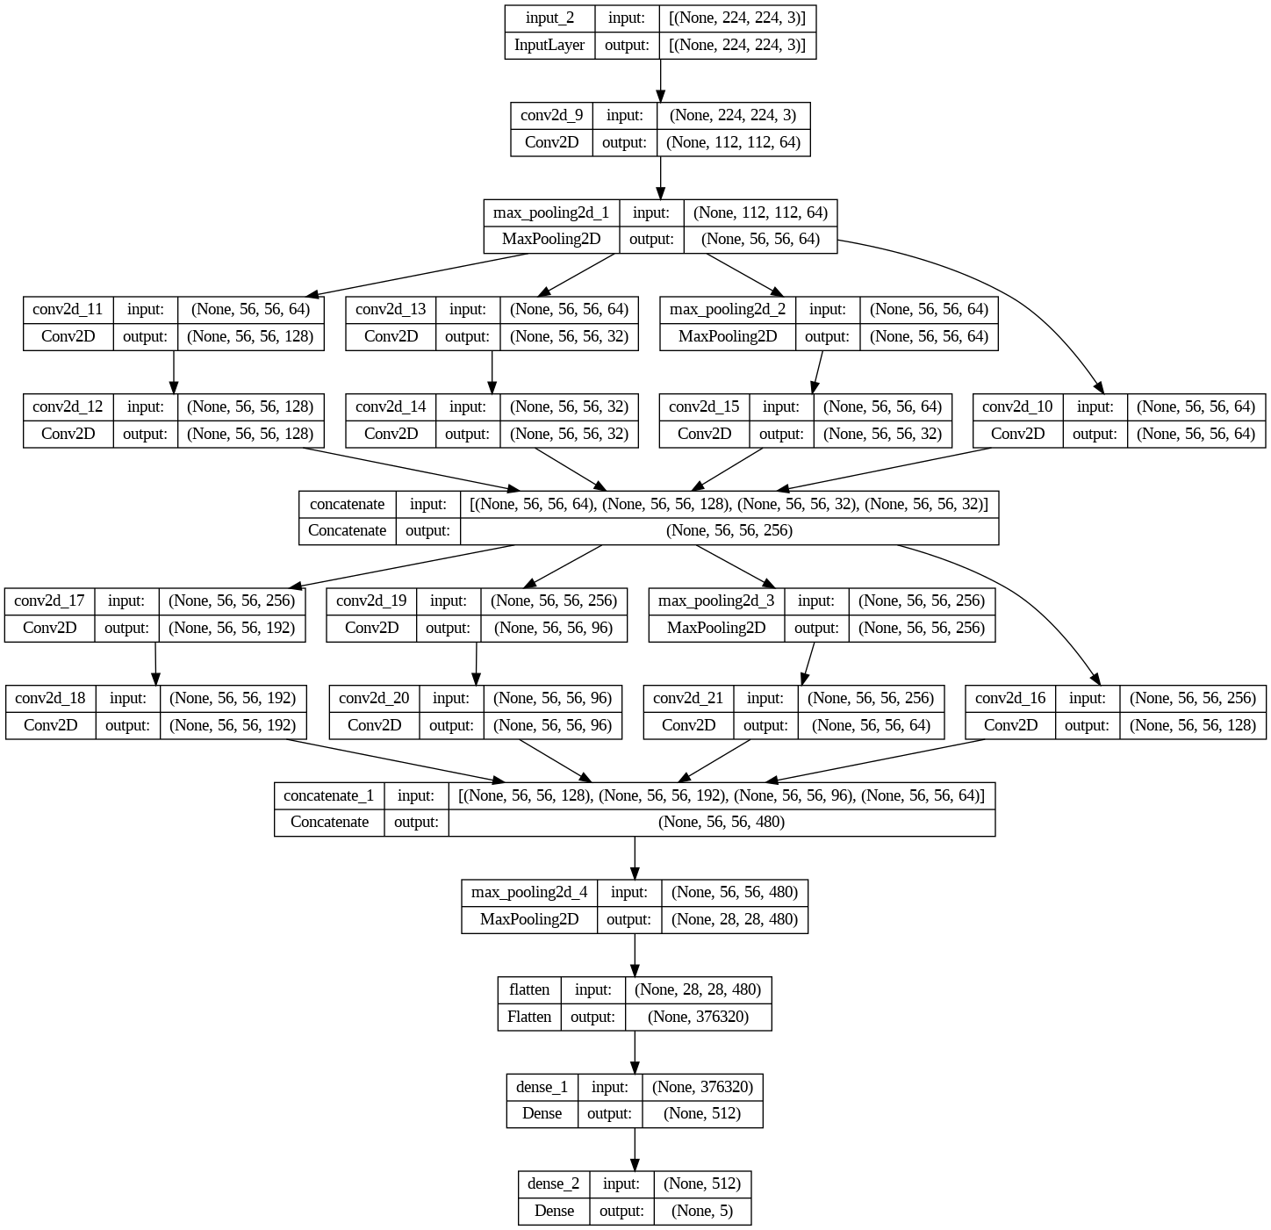
Structure
Of inception

Slide 11
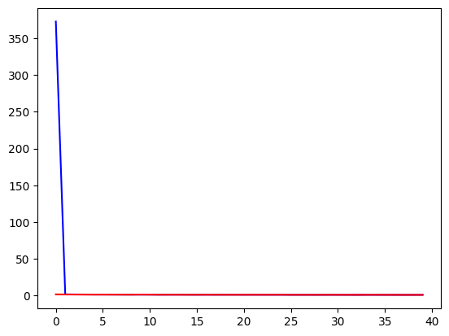
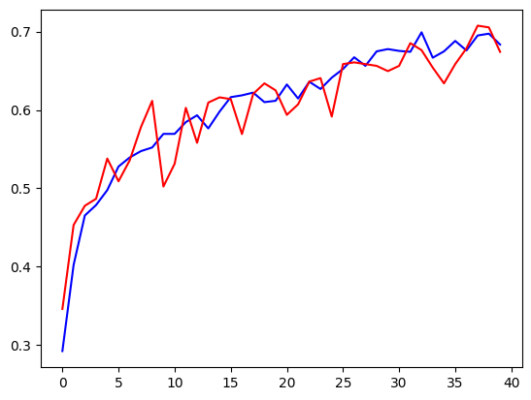
History of train and test (inception)
Loss of train test accuracy of train test

Slide 12
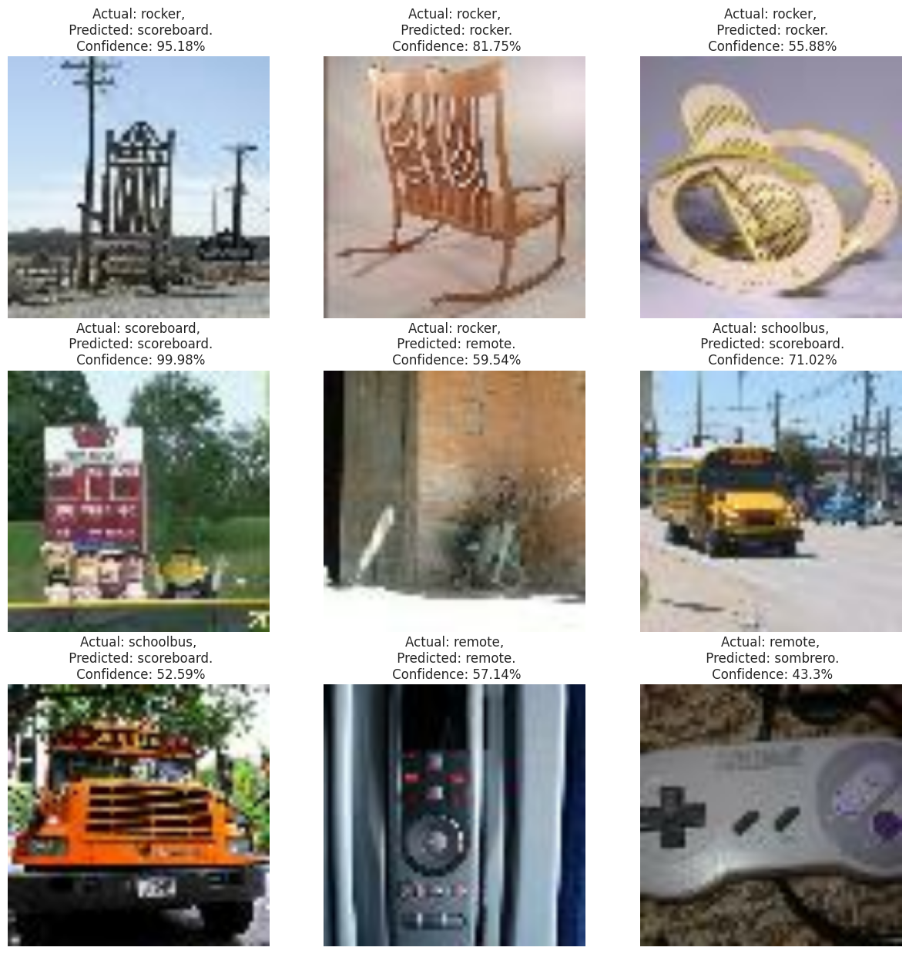
Misclassified test images

Slide 13
Custom model
Custom Inception Block
Custom InceptionNet Model
Architecture Customization
Input and Output Layers
Model Summary

Slide 14
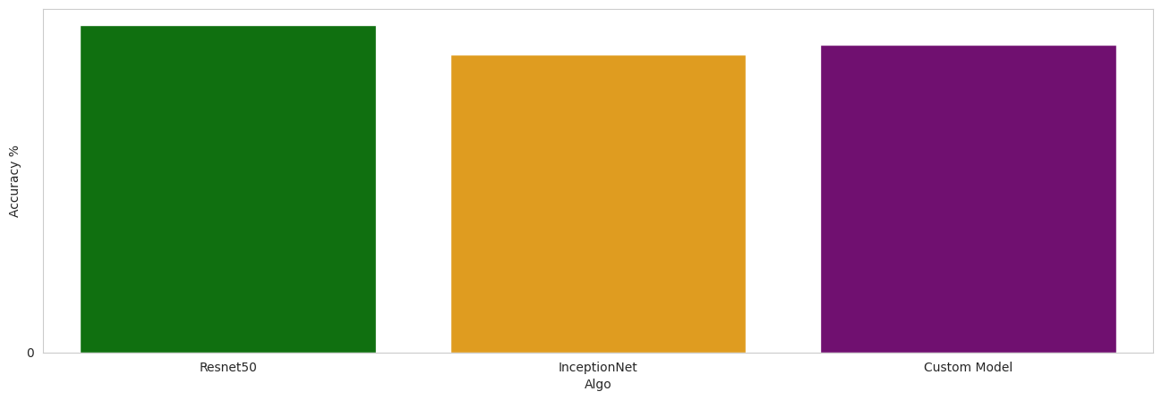
Decision
Misclassified test images

Slide 15
THank you

